Slide 1

PDA Workshop, Session: 2024-25
UNIT-4
INTRODUCTION TO TENSOR FLOW AND AI
Trainer
Garima Jain
Assistant Professor & Deputy Head of CSBS

Slide 2
Topics to be covered
Introduction, Using TensorFlow for AI Systems,
Up and Running with TensorFlow,
Understanding TensorFlow Basics,
Convolutional Neural Networks,
Working with Text and Sequences, and
TensorBoard Visualization,
Word Vectors,
Advanced RNN, and Embedding Visualization.
TensorFlow Abstractions and Simplifications,
Queues, Threads, and Reading Data,
Distributed TensorFlow,
Exporting and Serving Models with TensorFlow.

Slide 3
Introduction, Using TensorFlow for AI Systems,
TensorFlow is an open-source machine learning framework that facilitates the creation, training, and deployment of AI models.
Developed by Google Brain.
It supports a wide variety of applications, from computer vision to natural language processing and beyond. Whether you are building deep learning models, reinforcement learning agents, or simple machine learning algorithms, TensorFlow offers the tools needed to power your AI systems.

Slide 4
Up and Running with TensorFlow
Install TensorFlow in the virtual environment:
bash
Install TensorFlow
To install the latest stable version of TensorFlow
pip install tensorflow
To install TensorFlow with GPU support, use:
pip install tensorflow-gpu
Install in a Virtual Environment (Recommended)
Create a virtual environment:
python -m venv tensorflow_env
Activate the environment:
For Windows:
tensorflow_env\Scripts\activate
For macOS/Linux:
source tensorflow_env/bin/activate
Simple Model: https://colab.research.google.com/drive/1bz2rqtOZcXd2OUobHGgvyVkFsr47Be3H?usp=sharing

Slide 5
Understanding TensorFlow Basics
TensorFlow is a versatile and powerful library for building machine learning and deep learning models. Let's break down some of the core concepts of TensorFlow and explore them with code examples:
Tensors: The core data structure in TensorFlow
Operations: How to perform mathematical operations on tensors
Graphs and Sessions: How TensorFlow executes computations (in older versions of TensorFlow, this was done using graphs and sessions, but newer TensorFlow uses eager execution by default)
Variables: Variables hold and update parameters for models
Keras API: A high-level API for building neural networks, part of TensorFlow

Slide 6
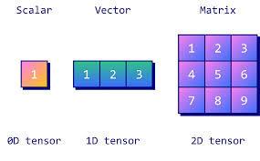
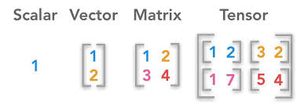
TensorFlow Basics
Tensors: The Core Data Structure in TensorFlow
A tensor is a multi-dimensional array or matrix that contains elements of a single data type.
Operations on Tesnors
https://colab.research.google.com/drive/1dwxNOYw3QMGQobk4ySB3p5-tQahHjiL8?usp=sharing

Slide 7
Convolutional Neural Networks
Tensors: The Core Data Structure in TensorFlow
A tensor is a multi-dimensional array or matrix that contains elements of a single data type.
Operations on Tesnors
https://colab.research.google.com/drive/1dwxNOYw3QMGQobk4ySB3p5-tQahHjiL8?usp=sharing

Slide 8
UNIT-2 Introduction to CNN
CNN stands for Convolutional Neural Network.
It is a specialized type of ANN that has proven to be highly effective in various computer vision tasks, such as image classification, object detection, and image segmentation.
CNNs are designed to automatically and adaptively learn patterns and features from input images, making them well-suited for tasks that involve analyzing visual data.

Slide 9
UNIT-2 Introduction to CNN
Advantages of Convolutional Neural Networks (CNNs):
Good at detecting patterns and features in images, videos, and audio signals.
Robust to translation, rotation, and scaling invariance.
End-to-end training, no need for manual feature extraction.
Can handle large amounts of data and achieve high accuracy.
Disadvantages of Convolutional Neural Networks (CNNs):
Computationally expensive to train and require a lot of memory.
Can be prone to overfitting if not enough data or proper regularization is used.
Requires large amounts of labeled data.
Interpretability is limited, it’s hard to understand what the network has learned.

Slide 10
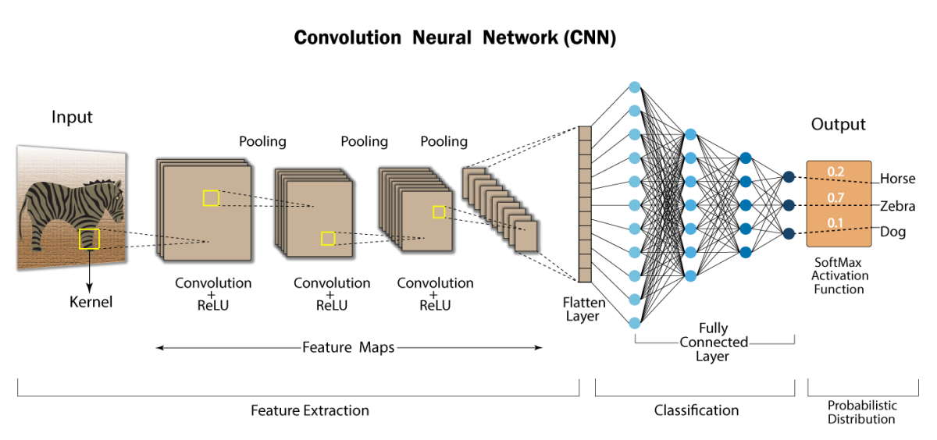
UNIT-2 Introduction to CNN

Slide 11
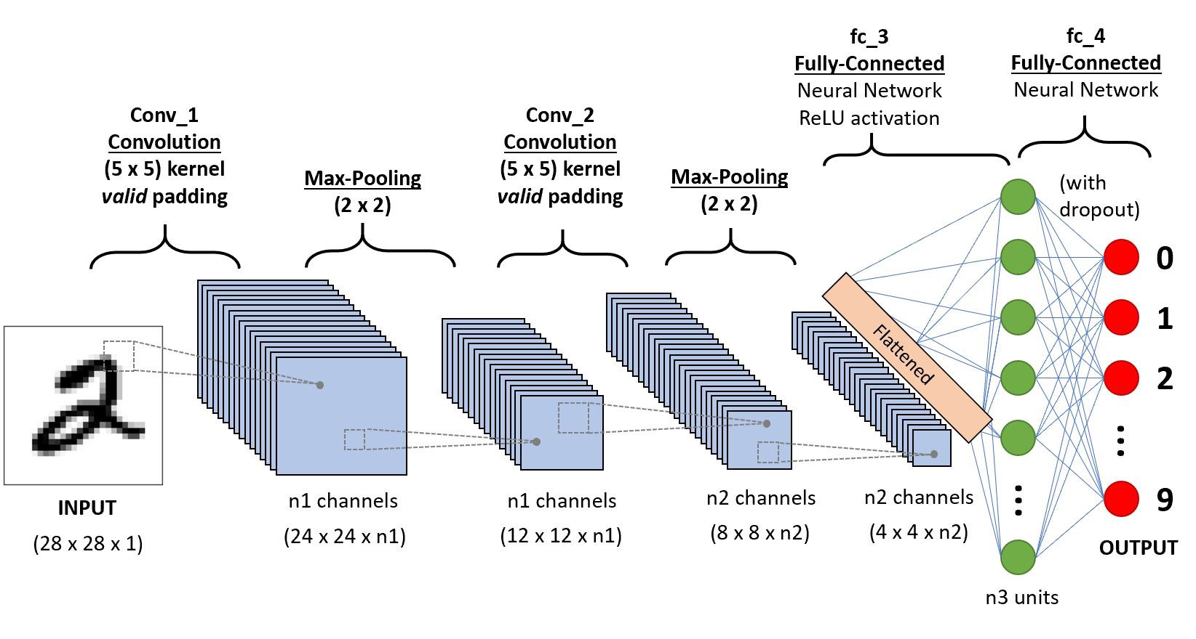
UNIT-2 Introduction to CNN

Slide 12
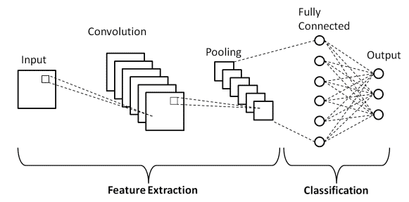
UNIT-2 Introduction to CNN
Basic Architecture

Slide 13
UNIT-2 Introduction to CNN
Basic Architecture
There are two main parts to a CNN architecture
A convolution tool that separates and identifies the various features of the image for analysis in a process called as Feature Extraction.
The network of feature extraction consists of many pairs of convolutional or pooling layers.
A fully connected layer that utilizes the output from the convolution process and predicts the class of the image based on the features extracted in previous stages.
This CNN model of feature extraction aims to reduce the number of features present in a dataset.
It creates new features which summarises the existing features contained in an original set of features.
There are many CNN layers as shown in the CNN architecture diagram.

Slide 14
UNIT-2 Introduction to CNN
Convolution Layers
There are three types of layers that make up the CNN which are the convolutional layers, pooling layers, and fully-connected (FC) layers.
When these layers are stacked, a CNN architecture will be formed.
In addition to these three layers, there are two more important parameters which are the dropout layer and the activation function which are defined below.
1. Convolutional Layer
This layer is the first layer that is used to extract the various features from the input images.
In this layer, the mathematical operation of convolution is performed between the input image and a filter of a particular size MxM.
By sliding the filter over the input image, the dot product is taken between the filter and the parts of the input image with respect to the size of the filter (MxM).
The output is termed as the Feature map which gives us information about the image such as the corners and edges.
Later, this feature map is fed to other layers to learn several other features of the input image.
The convolution layer in CNN passes the result to the next layer once applying the convolution operation in the input.
Convolutional layers in CNN benefit a lot as they ensure the spatial relationship between the pixels is intact.

Slide 15
UNIT-2 Introduction to CNN
2. Pooling Layer
In most cases, a Convolutional Layer is followed by a Pooling Layer.
The primary aim of this layer is to decrease the size of the convolved feature map to reduce the computational costs.
This is performed by decreasing the connections between layers and independently operates on each feature map.
Depending upon method used, there are several types of Pooling operations. It basically summarises the features generated by a convolution layer.
In Max Pooling, the largest element is taken from feature map.
Average Pooling calculates the average of the elements in a predefined sized Image section.
The total sum of the elements in the predefined section is computed in Sum Pooling.
The Pooling Layer usually serves as a bridge between the Convolutional Layer and the FC Layer.
This CNN model generalises the features extracted by the convolution layer, and helps the networks to recognise the features independently.

Slide 16
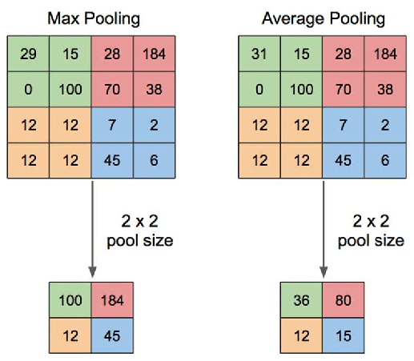
UNIT-2 Introduction to CNN
2. Types of Pooling Layer
Max Pooling
Max pooling is a pooling operation that selects the maximum element from the region of the feature map covered by the filter.
Thus, the output after max-pooling layer would be a feature map containing the most prominent features of the previous feature map.
Average Pooling
Average pooling computes the average of the elements present in the region of feature map covered by the filter.
Thus, while max pooling gives the most prominent feature in a particular patch of the feature map, average pooling gives the average of features present in a patch.

Slide 17
UNIT-2 Introduction to CNN
Advantages of Pooling Layer:
Dimensionality reduction: The main advantage of pooling layers is that they help in reducing the spatial dimensions of the feature maps. This reduces the computational cost and also helps in avoiding overfitting by reducing the number of parameters in the model.
Translation invariance: Pooling layers are also useful in achieving translation invariance in the feature maps. This means that the position of an object in the image does not affect the classification result, as the same features are detected regardless of the position of the object.
Feature selection: Pooling layers can also help in selecting the most important features from the input, as max pooling selects the most salient features and average pooling preserves more information.

Slide 18
UNIT-2 Introduction to CNN
Disadvantages of Pooling Layer:
Information loss: One of the main disadvantages of pooling layers is that they discard some information from the input feature maps, which can be important for the final classification or regression task.
Over-smoothing: Pooling layers can also cause over-smoothing of the feature maps, which can result in the loss of some fine-grained details that are important for the final classification or regression task.
Hyperparameter tuning: Pooling layers also introduce hyperparameters such as the size of the pooling regions and the stride, which need to be tuned in order to achieve optimal performance. This can be time-consuming and requires some expertise in model building.

Slide 19
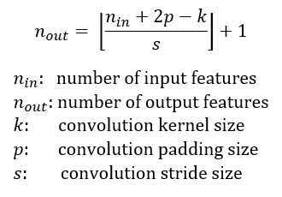
UNIT-2 Introduction to CNN
Feature Map Size Calculation Formula

Slide 20
UNIT-2 Introduction to CNN
Padding
Padding is a technique used to preserve the spatial dimensions of the input image after convolution operations on a feature map.
Padding involves adding extra pixels around the border of the input feature map before convolution.
This can be done in two ways:
Valid Padding: In the valid padding, no padding is added to the input feature map, and the output feature map is smaller than the input feature map. This is useful when we want to reduce the spatial dimensions of the feature maps.
Same Padding: In the same padding, padding is added to the input feature map such that the size of the output feature map is the same as the input feature map. This is useful when we want to preserve the spatial dimensions of the feature maps.

Slide 21
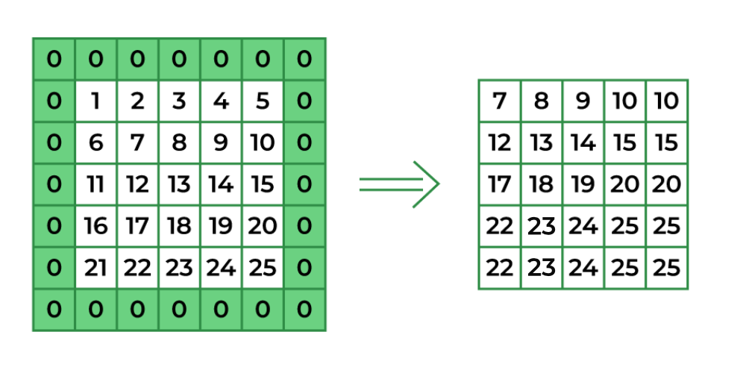
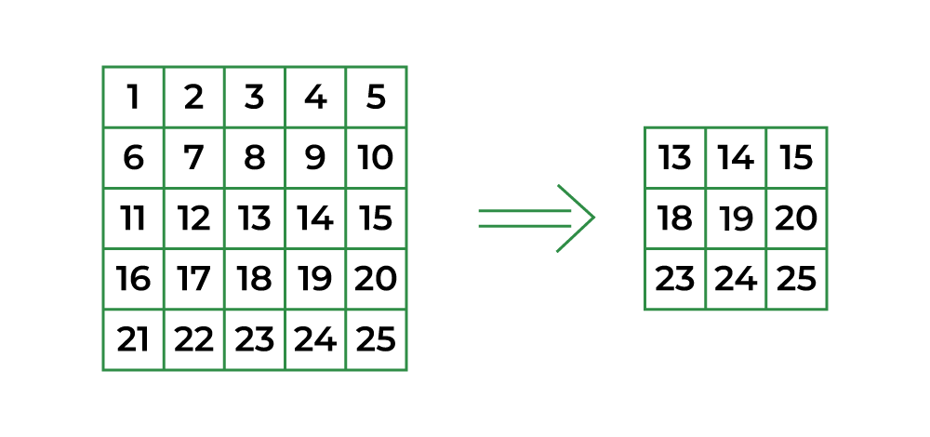
UNIT-2 Introduction to CNN
Padding
Same Padding
same padding adds additional rows and columns of pixels around the edges of the input data so that the size of the output feature map is the same as the size of the input data. This is achieved by adding rows and columns of pixels with a value of zero around the edges of the input data before the convolution operation.
Valid Padding
Valid padding is used when it is desired to reduce the size of the output feature map in order to reduce the number of parameters in the model and improve its computational efficiency.

Slide 22
UNIT-2 Introduction to CNN
Padding
The most common padding value is zero-padding, which involves adding zeros to the borders of the input feature map.
Padding can help in reducing the loss of information at the borders of the input feature map and can improve the performance of the model.
However, it also increases the computational cost of the convolution operation.
Overall, padding is an important technique in CNNs that helps in preserving the spatial dimensions of the feature maps and can improve the performance of the model.

Slide 23
UNIT-2 Introduction to CNN
Reasons of using Striding in CNNs
Downsampling: Striding with a larger value helps downsample the feature map, reducing its spatial dimensions. This can be beneficial in reducing computational complexity and memory usage, especially in deep networks.
Increasing Receptive Field: Larger strides can increase the receptive field of neurons in deeper layers, allowing them to capture information from a larger portion of the input image.
Dimension Reduction: Striding can be used to reduce the spatial dimensions of the feature map gradually as you move deeper into the network, which can be helpful in certain tasks like object detection and image classification.

Slide 24
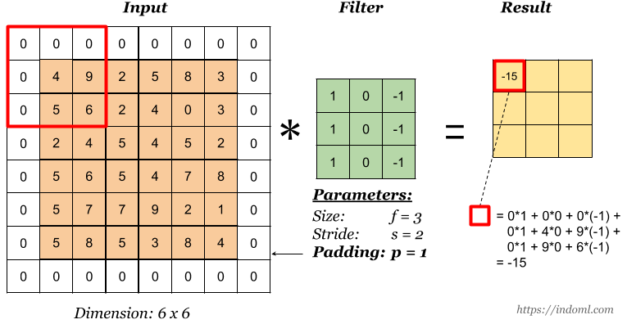
UNIT-2 Introduction to CNN
Example of padding = 1 and striding = 2

Slide 25
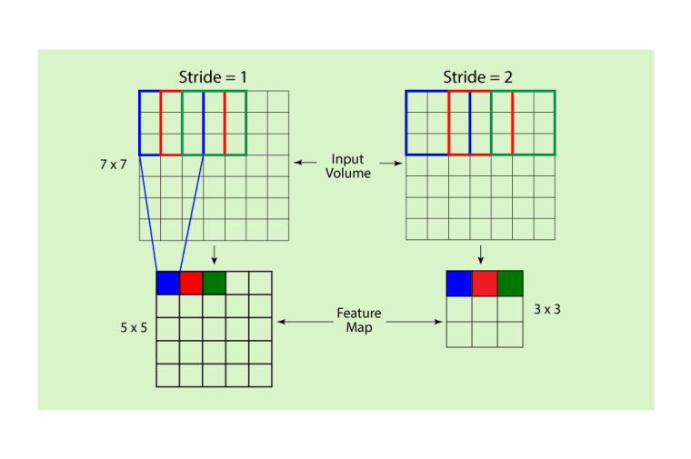
UNIT-2 Introduction to CNN
Striding
"striding" refers to the step size or the distance by which the convolutional filter or kernel moves across the input image during the convolution operation.
Striding is an important parameter that determines how much the output feature map's spatial dimensions are reduced compared to the input.

Slide 26
UNIT-2 Introduction to CNN
Parameter Calculation
In Convolutional Neural Networks (CNNs), parameter calculation refers to determining the number of learnable parameters (weights and biases) that need to be optimized during training.
These parameters help the model learn the mapping between input data and output predictions.
step by step calculation for parameters.

Slide 27
UNIT-2 Introduction to CNN
1. Convolutional Layer
The convolutional layer consists of filters (kernels) that convolve over the input data to extract features.
Parameters in a Convolutional Layer:
Filter size (K x K): A filter (also called a kernel) is a small matrix used to convolve over the input. The dimensions of this filter are K×K, where K is typically a small value like 3, 5, or 7.
Number of filters (F): The number of filters used to capture different features in the input. For example, if you use 32 filters, the output depth will be 32.
Input depth (C): The depth of the input (for example, 3 channels for RGB images).

Slide 28
UNIT-2 Introduction to CNN
Parameter Calculation for a Convolutional Layer:
Number of parameters per filter = K×K×C+1 (the extra 1 is for the bias term)
K×K×C is the number of weights for each filter, where C is the input depth.
+1 is for the bias term for each filter.
Total parameters = Number of filters F × (Number of parameters per filter)
So the total parameters for a convolutional layer are calculated as:
Total Parameters=F×(K×K×C+1)

Slide 29
UNIT-2 Introduction to CNN
2. Fully Connected Layer (Dense Layer)
A fully connected layer connects every neuron to every neuron in the previous layer. The number of parameters in a fully connected layer depends on the number of inputs (neurons from the previous layer) and the number of neurons in the current layer.
Parameters in a Fully Connected Layer:
Input size (N): The number of neurons from the previous layer (for example, after flattening the output of the convolutional layers).
Number of neurons (M): The number of neurons in the current layer.
Bias: Each neuron in the fully connected layer has a bias.
Parameter Calculation for a Fully Connected Layer:
Number of parameters = N×M+M
N×M represents the weights between each input neuron and each output neuron.
+M accounts for the bias terms for each output neuron.

Slide 30
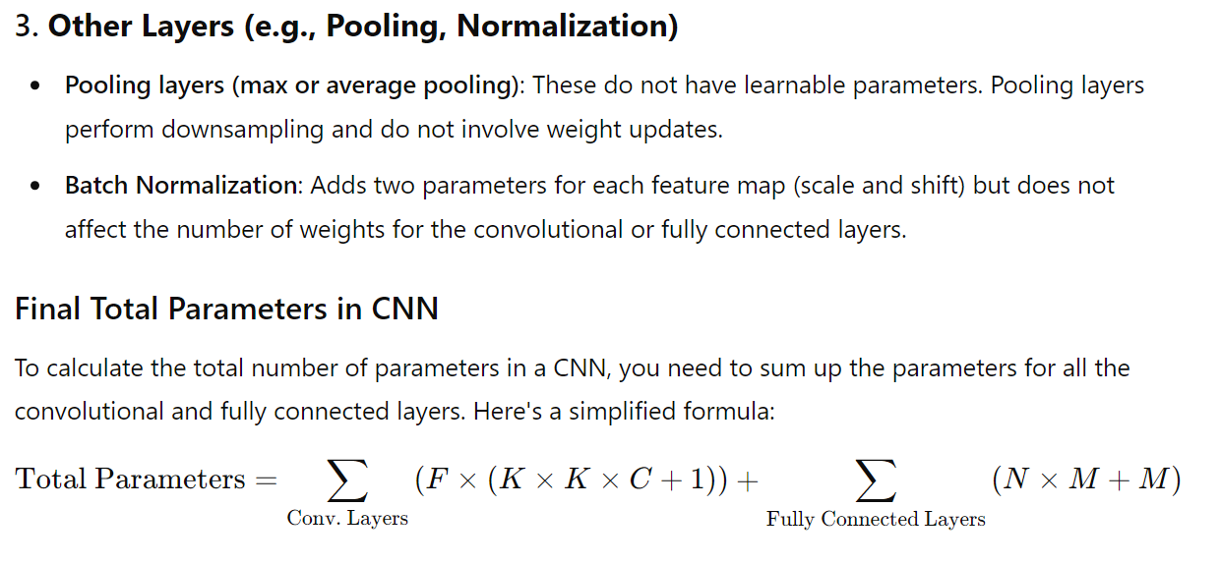
UNIT-2 Introduction to CNN

Slide 31
UNIT-2 Introduction to CNN
Implementation of Padding and Striding
Simple CNN visualization
https://colab.research.google.com/drive/116QNuxPQtxhb-1zqyWqDIboYh2GzTvDD?authuser=1#scrollTo=Esb12gcaa9V_
https://colab.research.google.com/drive/1LJUx72Qkp756U1mT9BQcW19n9TF-VToH?usp=sharing

Slide 32
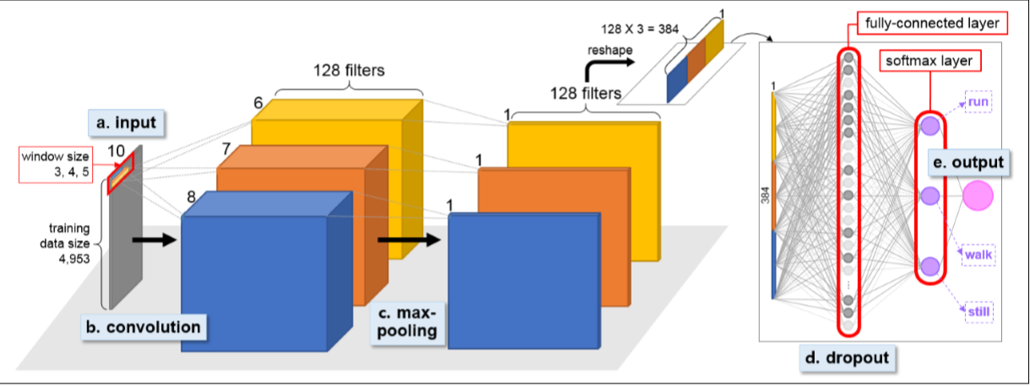
UNIT-2 Introduction to CNN
3. Fully Connected Layer

Slide 33
UNIT-2 Introduction to CNN
3. Fully Connected Layer
The Fully Connected (FC) layer consists of the weights and biases along with the neurons and is used to connect the neurons between two different layers.
These layers are usually placed before the output layer and form the last few layers of a CNN Architecture.
In this, the input image from the previous layers are flattened and fed to the FC layer.
The flattened vector then undergoes few more FC layers where the mathematical functions operations usually take place.
In this stage, the classification process begins to take place.
The reason two layers are connected is that two fully connected layers will perform better than a single connected layer.
These layers in CNN reduce the human supervision

Slide 34
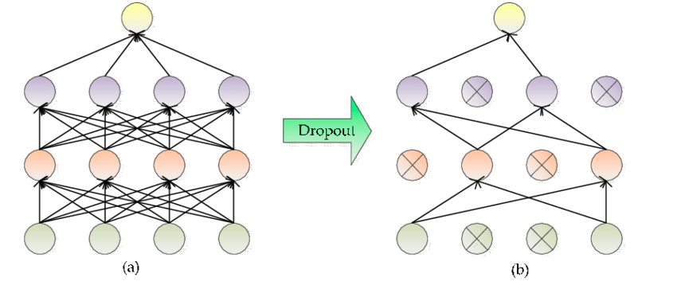
UNIT-2 Introduction to CNN
4. Dropout

Slide 35
UNIT-2 Introduction to CNN
4. Dropout
When all the features are connected to the FC layer, it can cause overfitting in the training dataset.
Overfitting occurs when a particular model works so well on the training data causing a negative impact in the model’s performance when used on a new data.
To overcome this problem, a dropout layer is utilised wherein a few neurons are dropped from the neural network during training process resulting in reduced size of the model.
On passing a dropout of 0.3, 30% of the nodes are dropped out randomly from the neural network.
Dropout results in improving the performance of a machine learning model as it prevents overfitting by making the network simpler.
It drops neurons from the neural networks during training.

Slide 36
UNIT-2 Introduction to CNN
5. Activation Functions
Finally, one of the most important parameters of the CNN model is the activation function.
They are used to learn and approximate any kind of continuous and complex relationship between variables of the network.
It decides which information of the model should fire in the forward direction and which ones should not at the end of the network.
It adds non-linearity to the network.
There are several commonly used activation functions such as the ReLU, Softmax, tanH and the Sigmoid functions.
Each of these functions have a specific usage. For a binary classification CNN model, sigmoid and softmax functions are preferred and for a multi-class classification, generally softmax us used.

Slide 37
UNIT-2 Text Classification
Text classification is the process of categorizing text data into predefined groups or labels.
Text Classification is the task of assigning a sentence or document an appropriate category. The categories depend on the chosen dataset and can range from topics.
It is a type of supervised learning, where a machine learning model learns from a labeled dataset and then predicts the category of unseen data.
Text Classification problems include emotion classification, news classification, citation intent classification, among others.
Text classification can also be applied to various tasks such as spam detection, sentiment analysis, topic categorization, and language identification.
Benchmark datasets for evaluating text classification capabilities include GLUE, AGNews, among others.
The primary goal of text classification is to automatically assign a category or class to a given text based on its content.

Slide 38
UNIT-2 Steps in Text Classification:
Data Collection: You need a labeled dataset where each text sample is associated with a category label. The quality and quantity of data significantly impact the performance of a text classification model.
Text Preprocessing: Text data is often noisy and unstructured, so preprocessing is crucial. The preprocessing steps may include:
Tokenization: Splitting the text into smaller pieces (tokens), typically words or sentences.
Lowercasing: Converting all the text to lowercase to maintain uniformity.
Stopword Removal: Removing common words such as "the", "and", "is", etc., that do not contribute much to the meaning of the text.
Stemming or Lemmatization: Reducing words to their root form, e.g., "running" → "run".
Punctuation Removal: Removing unnecessary punctuation marks.
Vectorization: Converting text into numerical features using techniques like Bag of Words (BoW), Term Frequency-Inverse Document Frequency (TF-IDF), or word embeddings (Word2Vec, GloVe, etc.).

Slide 39
UNIT-2 Steps in Text Classification:
Feature Extraction: Once the text is preprocessed, the next step is to convert the text into numerical representations (vectors). This allows the machine learning model to process the text effectively. Some common methods include:
Bag of Words (BoW): This method represents each document as a vector of word frequencies.
TF-IDF: This technique takes into account the frequency of terms within a document and the rarity of those terms across a corpus, assigning higher weight to rare words.
Word Embeddings: These are dense vector representations of words in a continuous vector space, capturing semantic meanings and relationships between words.
Model Training: With the prepared feature set, you can train a classification model. Some popular models for text classification include:
Naive Bayes: A probabilistic classifier based on Bayes' theorem, often used for tasks like spam detection.
Support Vector Machines (SVM): A powerful classifier that tries to find the best boundary between different classes.
Deep Learning Models (e.g., CNNs, RNNs, Transformers): These models, especially with architectures like LSTMs, GRUs, or BERT, have proven highly effective in text classification tasks.

Slide 40
UNIT-2 Steps in Text Classification:
Model Evaluation: After training the model, it's essential to evaluate its performance. Common evaluation metrics include:
Accuracy: The proportion of correctly classified instances out of the total instances.
Precision: The proportion of true positives out of all predicted positives.
Recall: The proportion of true positives out of all actual positives.
F1-Score: The harmonic mean of precision and recall, providing a balance between the two.
Prediction: Once the model is trained and evaluated, you can use it to classify unseen text. The model will output a predicted category label for the new text.

Slide 41
UNIT-2 Terms used in Text Classification:
1. Text Corpus
A corpus (plural: corpora) is a large collection of text data used for training and evaluating text classification models. The corpus can consist of documents, sentences, or words, depending on the application.
Example: A corpus could be a collection of movie reviews, where each review is a document that will be labeled for sentiment (positive or negative).
2. Label/Category
A label or category is the class or category assigned to a given text. In supervised learning, each piece of text in the training dataset is associated with a label.
Example:
In a sentiment analysis task, the labels could be "positive" or "negative."
In spam detection, labels could be "spam" or "ham" (non-spam).

Slide 42
UNIT-2 Terms used in Text Classification:
3. Tokenization
Tokenization is the process of splitting a text into smaller units, typically words or phrases. Tokens are the building blocks used for analysis.
Example:
Text: "I love programming!"
Tokens: ["I", "love", "programming"]
4. Stop Words
Stop words are common words like "the", "and", "is", "to", etc., that do not carry significant meaning and are usually removed during preprocessing. The rationale is that these words do not help in distinguishing between different text categories.
Example:
Sentence: "The movie was amazing."
Stop words might be removed, leaving: "movie amazing."

Slide 43
UNIT-2 Terms used in Text Classification:
5. Stemming
Stemming is the process of reducing words to their root form. The idea is to treat different forms of the same word as equivalent.
Example:
"running" → "run"
"better" → "good"
6. Lemmatization
Lemmatization is similar to stemming, but it involves reducing a word to its dictionary form (lemma). Unlike stemming, lemmatization considers the context of a word and reduces it to a valid word (lemma) that exists in the dictionary.
Example:
"running" → "run"
"better" → "good"

Slide 44
UNIT-2 Terms used in Text Classification:
7. Feature Extraction
Feature extraction refers to the process of transforming raw text into numerical representations that can be fed into a machine learning model. These numerical features capture the important aspects of the text.
Common methods include:
Bag of Words (BoW): A simple representation where each word in a document is counted, and the frequency of each word is used as a feature.
TF-IDF (Term Frequency-Inverse Document Frequency): Weighs words by their frequency in a document and how rare they are in the entire corpus. It helps in reducing the importance of common words and emphasizes rare but significant words.
8. Vocabulary
A vocabulary refers to the set of unique words that exist in the corpus after preprocessing (tokenization, stopword removal, etc.). It forms the basis for vectorizing text.
Example: In the sentence "I love programming", the vocabulary could be ["I", "love", "programming"].

Slide 45
UNIT-2 Terms used in Text Classification:
7. Feature Extraction
Feature extraction refers to the process of transforming raw text into numerical representations that can be fed into a machine learning model. These numerical features capture the important aspects of the text.
Common methods include:
Bag of Words (BoW): A simple representation where each word in a document is counted, and the frequency of each word is used as a feature.
TF-IDF (Term Frequency-Inverse Document Frequency): Weighs words by their frequency in a document and how rare they are in the entire corpus. It helps in reducing the importance of common words and emphasizes rare but significant words.
8. Vocabulary
A vocabulary refers to the set of unique words that exist in the corpus after preprocessing (tokenization, stopword removal, etc.). It forms the basis for vectorizing text.
Example: In the sentence "I love programming", the vocabulary could be ["I", "love", "programming"].

Slide 46
UNIT-2 Terms used in Text Classification:
9. Bag of Words (BoW)
The Bag of Words (BoW) model is a simple text representation technique where the text is represented as a vector, and each word's frequency in the document is used as a feature. The order of words is ignored, making it a "bag" of words.
Example:
Document 1: "I love programming."
Document 2: "I enjoy coding."
BoW vectors could look like this:
Vocabulary: ["I", "love", "programming", "enjoy", "coding"]
Document 1: [1, 1, 1, 0, 0] (indicating the presence of "I", "love", and "programming")
Document 2: [1, 0, 0, 1, 1]

Slide 47
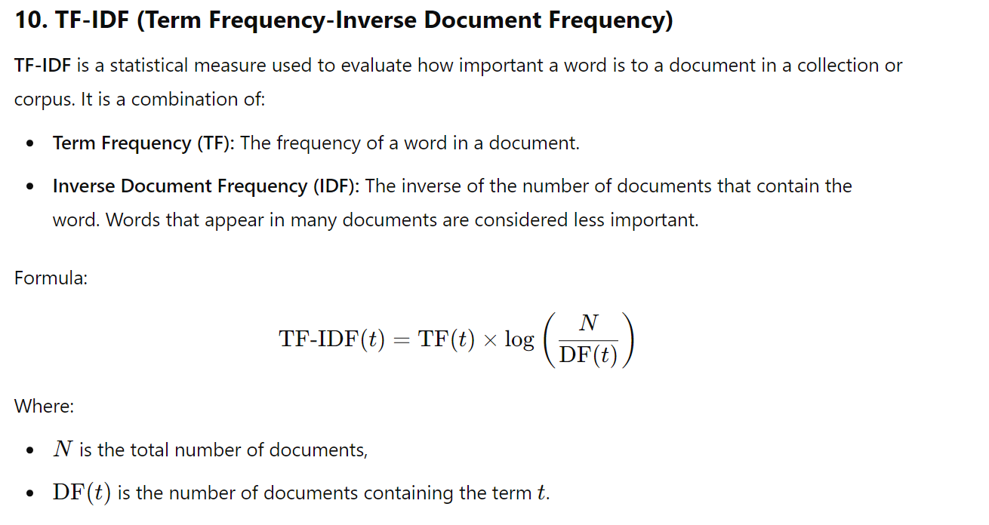
UNIT-2 Terms used in Text Classification:

Slide 48
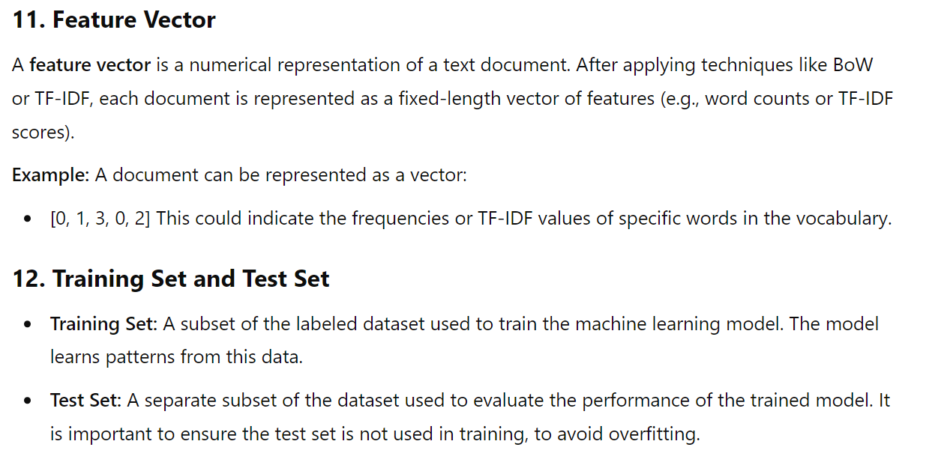
UNIT-2 Terms used in Text Classification:

Slide 49
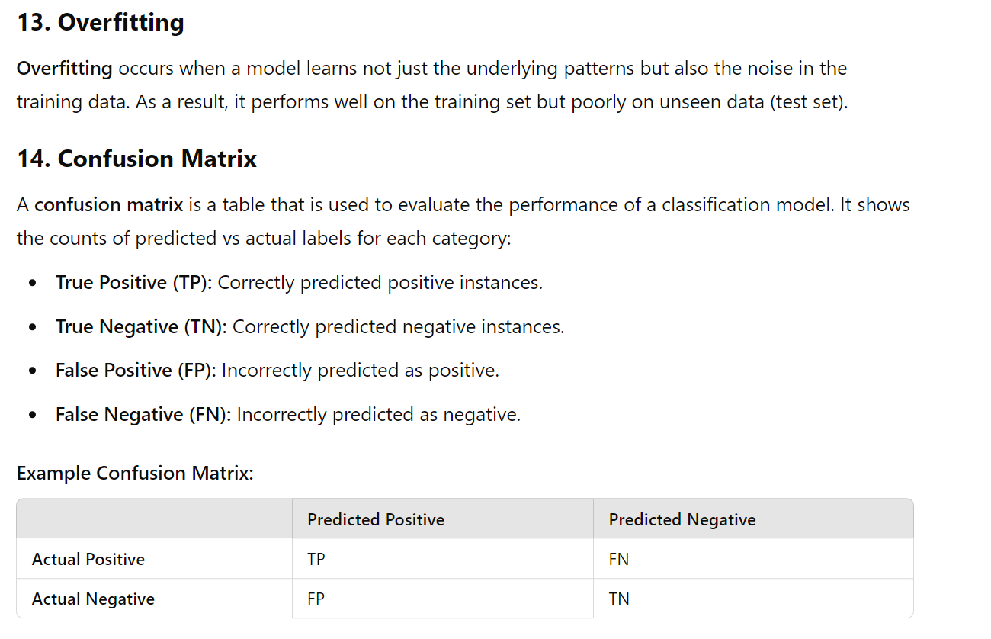
UNIT-2 Terms used in Text Classification:

Slide 50
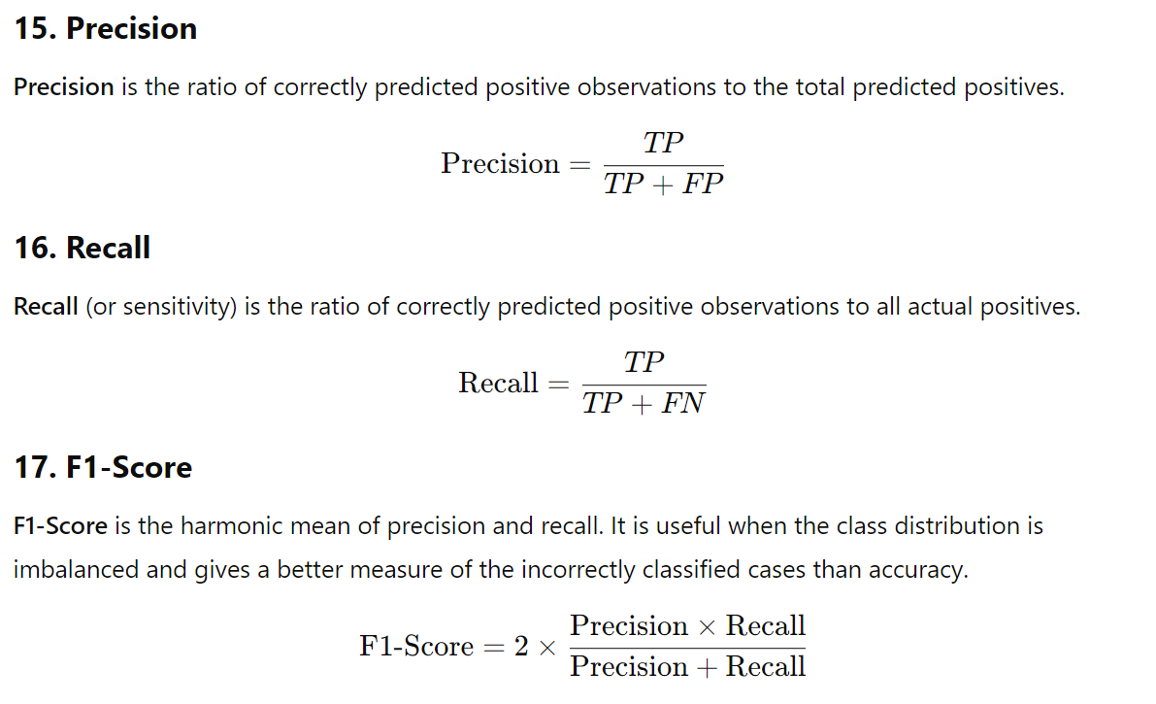
UNIT-2 Terms used in Text Classification:

Slide 51
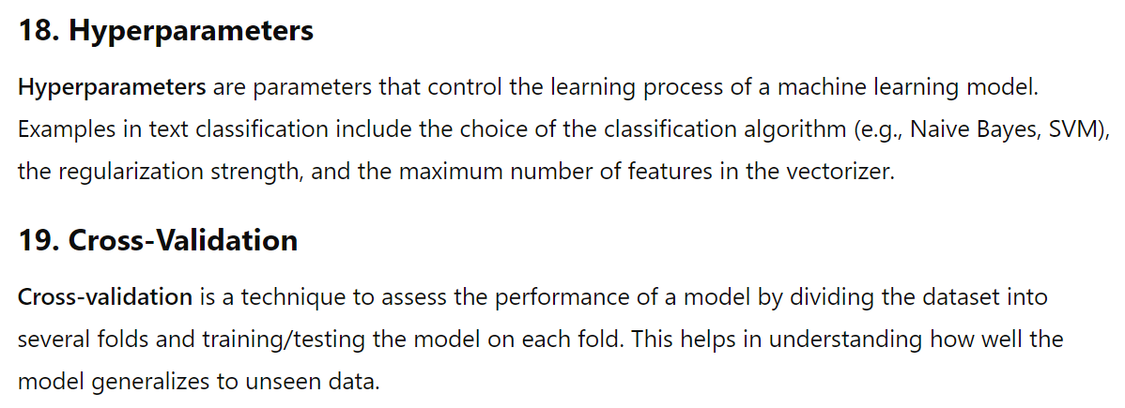
UNIT-2 Terms used in Text Classification:

Slide 52
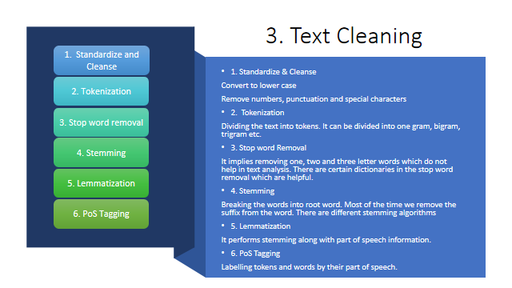
UNIT-2 Text Classification

Slide 53
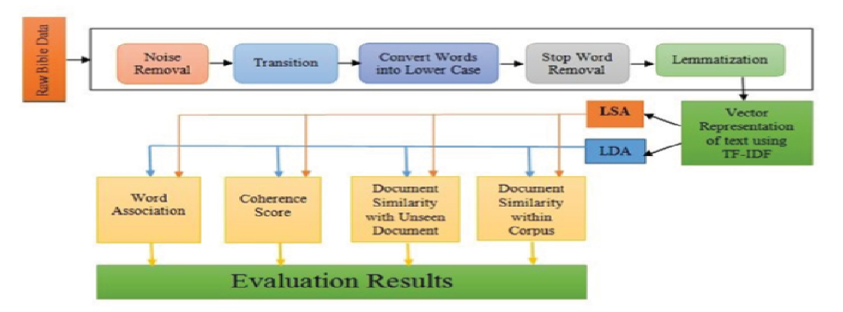
UNIT-2 Text Classification

Slide 54
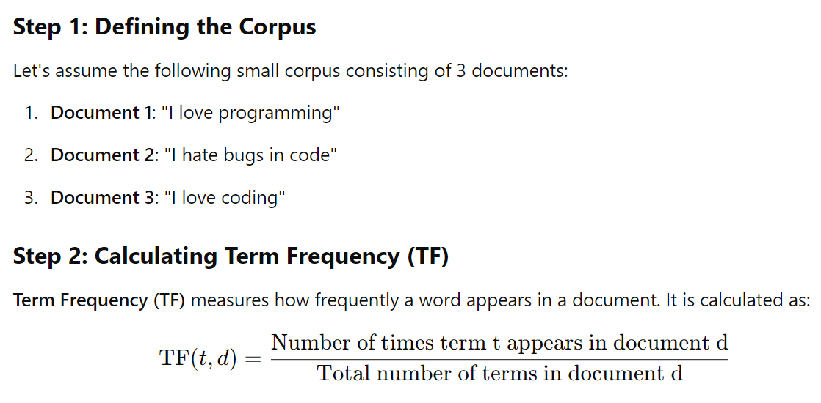
UNIT-2 Text Classification (Example)

Slide 55
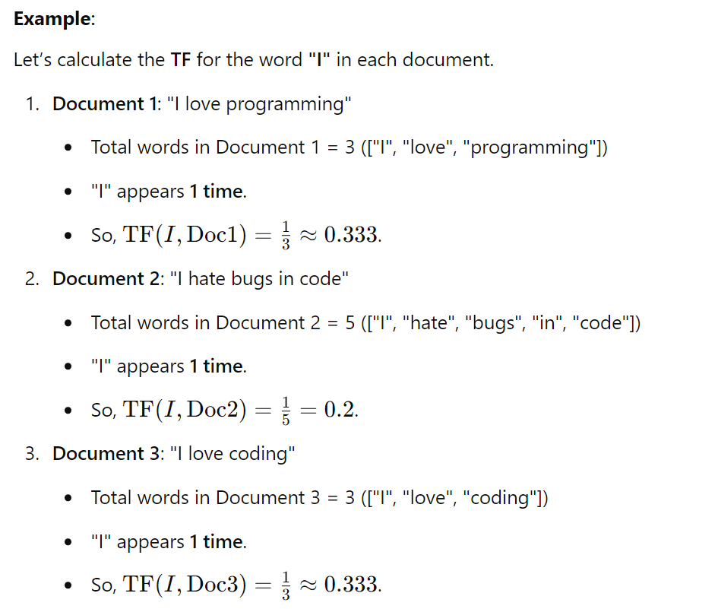
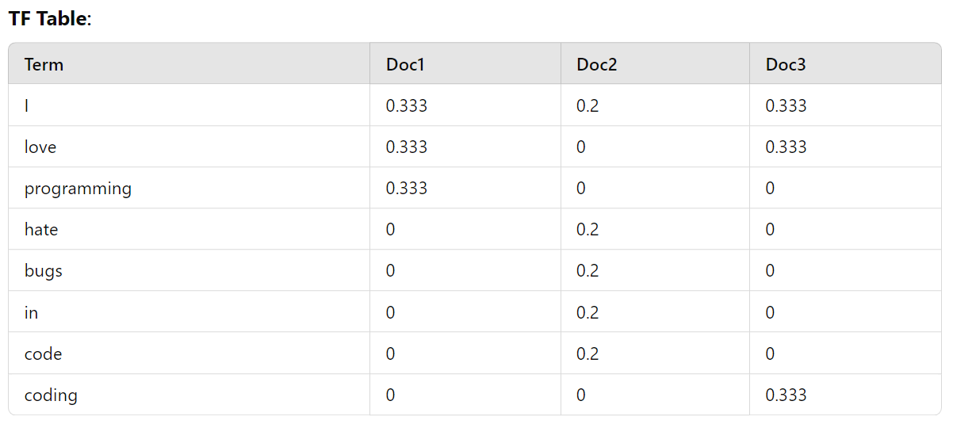
UNIT-2 Text Classification (Example)

Slide 56
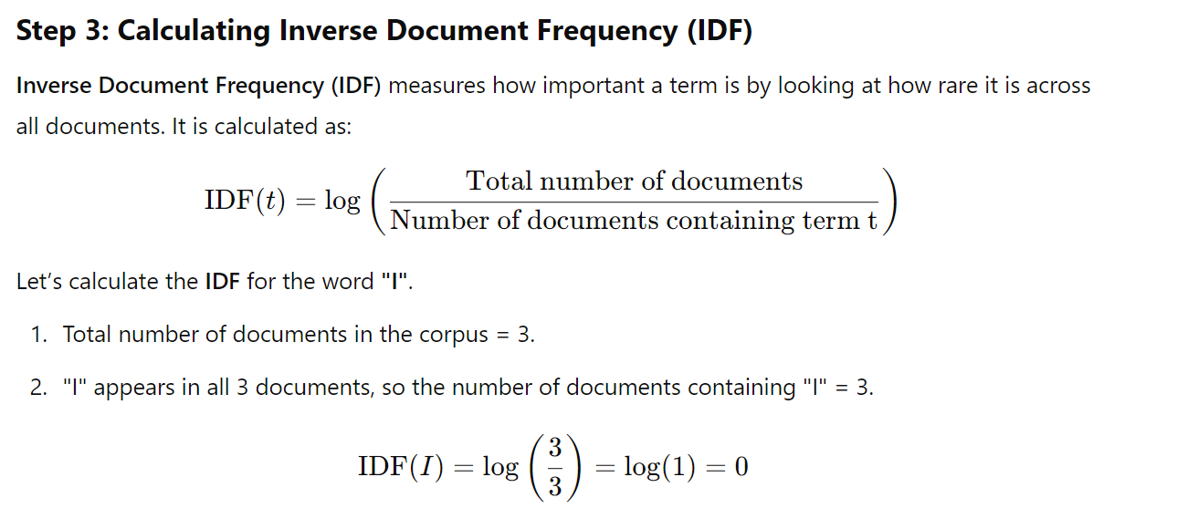
UNIT-2 Text Classification (Example)

Slide 57
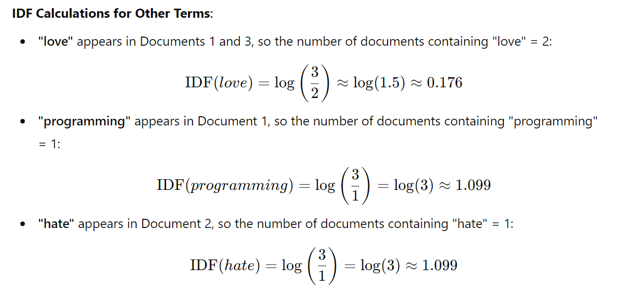
UNIT-2 Text Classification (Example)

Slide 58
UNIT-2 Text Classification (Example)

Slide 59
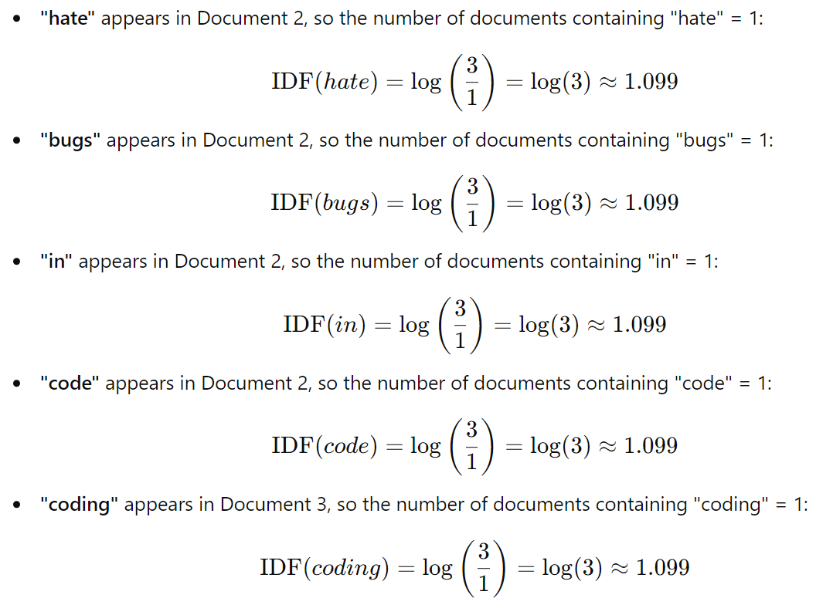
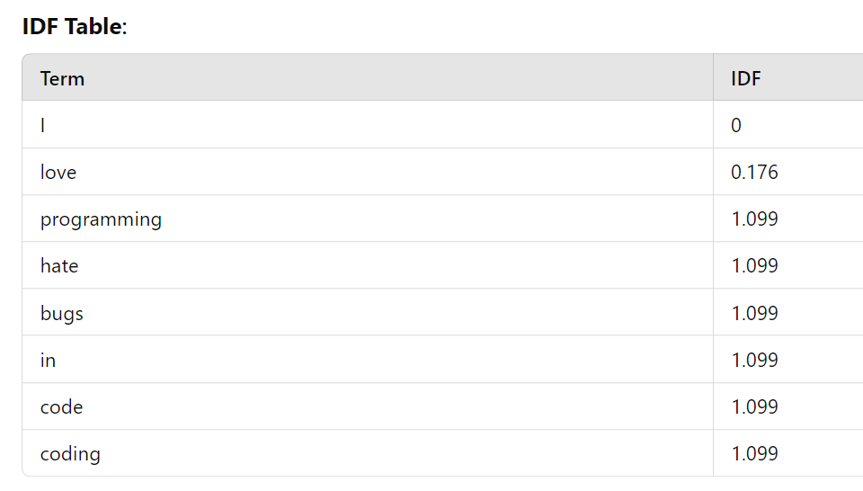
UNIT-2 Text Classification (Example)

Slide 60
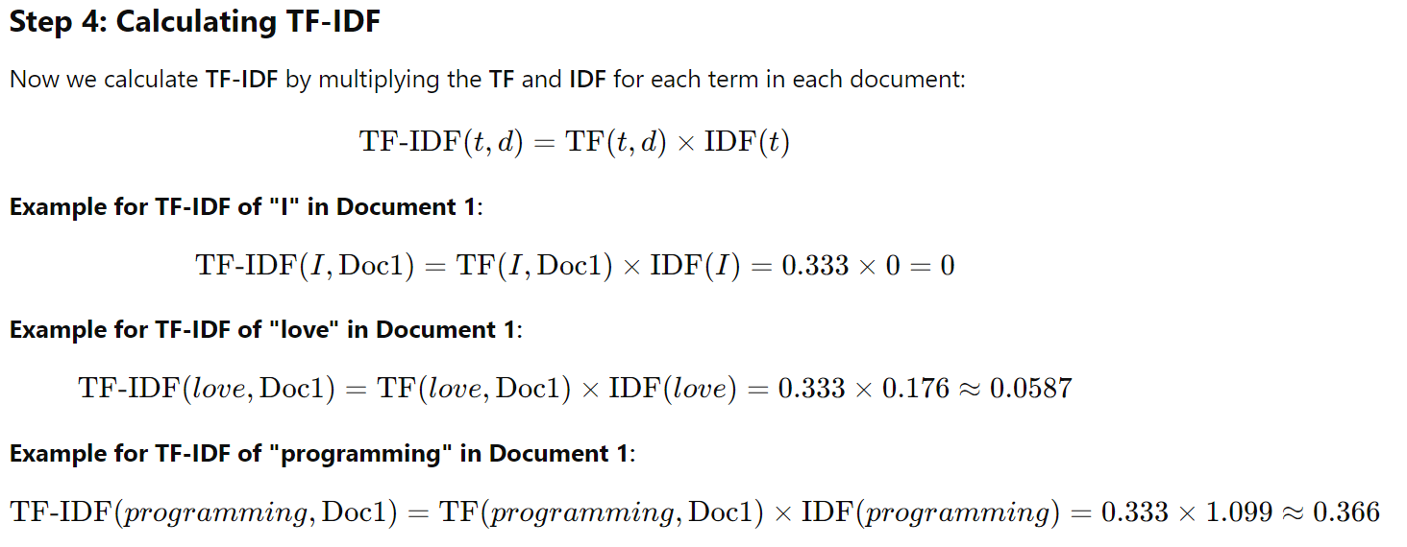
UNIT-2 Text Classification (Example)

Slide 61
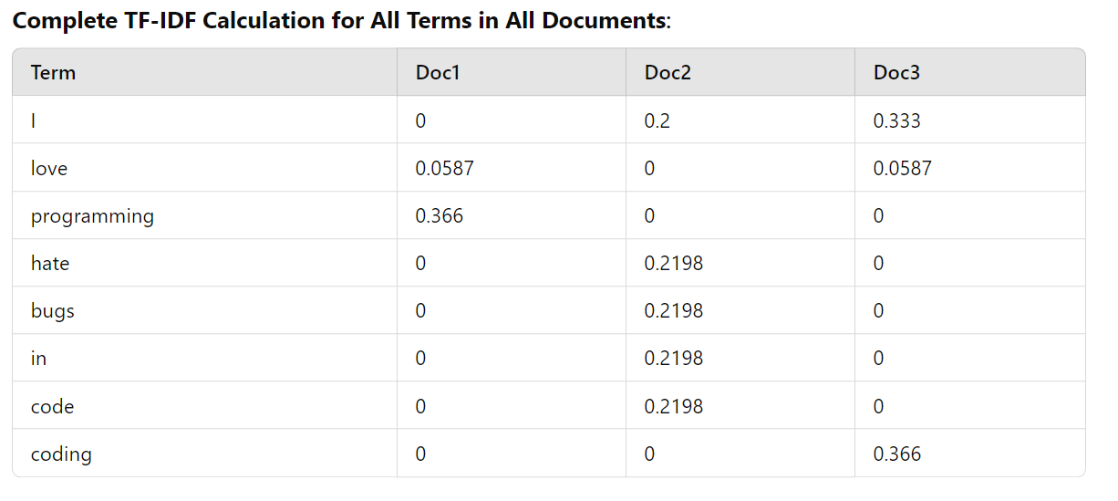
UNIT-2 Text Classification (Example)

Slide 62
UNIT-2 References
Book:
https://livebook.manning.com/book/transfer-learning-in-action/chapter-1/v-1/18
Text Sequence
https://colab.research.google.com/drive/1vdCZqWNKSb-TQBRyJvguwfgprnqD6k4q?usp=sharing
Text Classification: https://colab.research.google.com/drive/1CzSuEAb6bl7ke3iZiEhQgjM1NNGs9C4r?usp=sharing

